Slide 1

DC GAN Algorithm
For Fake Image Generation

Slide 2
What is DC GAN
Deep Convolutional Generative Adversarial Network), which is a type of generative model that uses deep convolutional neural networks to generate new images. The model consists of two neural networks: a generator network and a discriminator network.

Slide 3
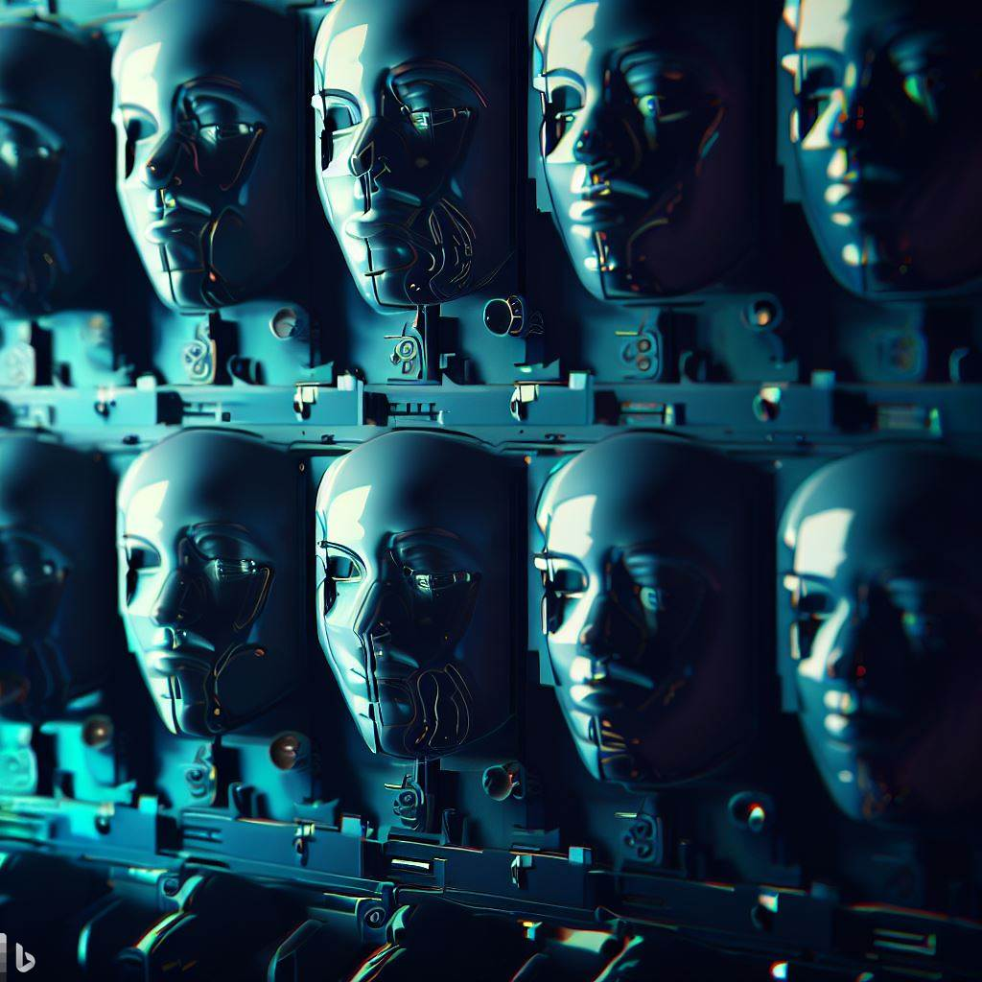
Generator Network
The generator network takes as input a random noise vector and generates a new image

Slide 4

Discriminator Network
the discriminator network takes as input an image and predicts whether it is real or fake (i.e., generated by the generator network)

Slide 5
How does it Work ?
The generator and discriminator are trained alternately, with the generator trying to generate realistic images that fool the discriminator, and the discriminator trying to distinguish between real and fake images.

Slide 6
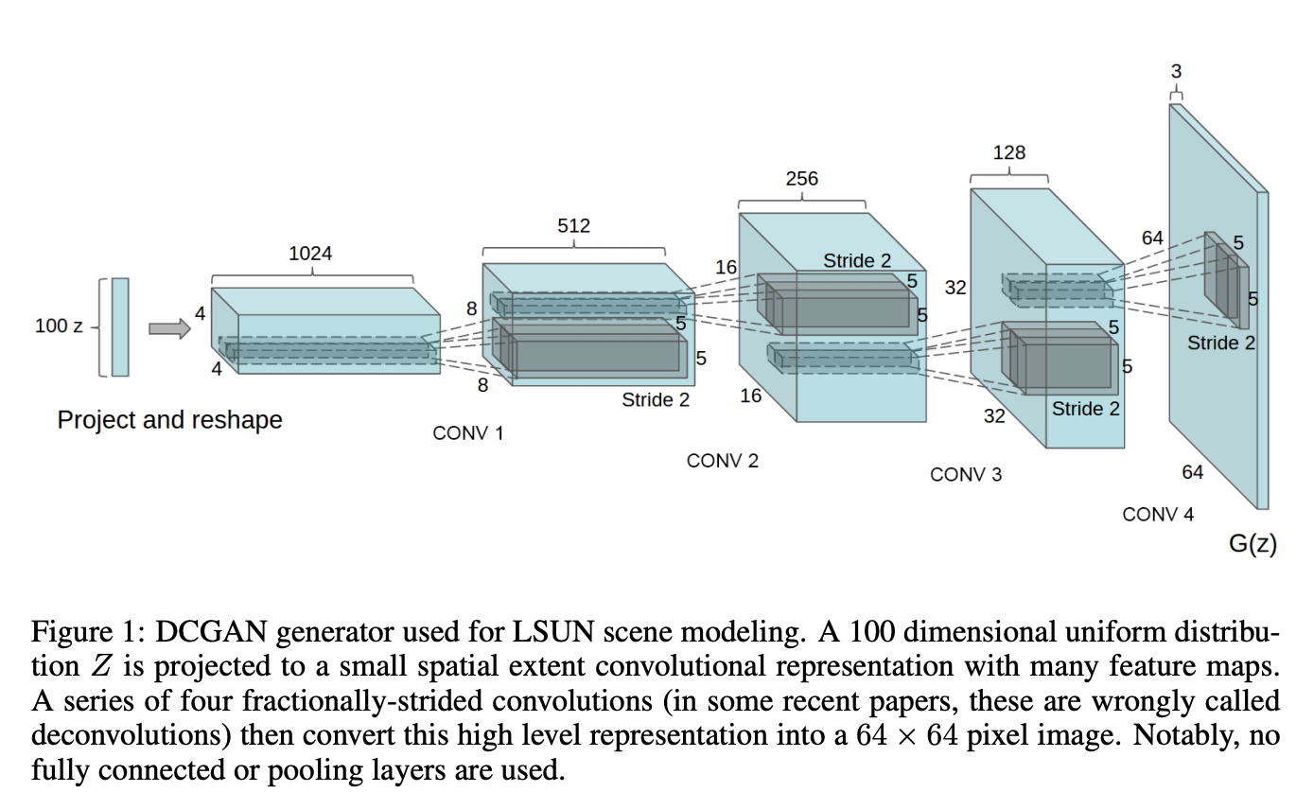
Deeper Look into Generator
The architecture of the generator network consists of several transposed convolutional layers with ReLU activation functions and batch normalization, followed by a final transposed convolutional layer that outputs an image.
The transposed convolutional layers are used to "upsample" the noise vector into a larger image, with each layer increasing the spatial resolution of the image while decreasing the number of channels. The final layer uses a tanh activation function to ensure that the output image has pixel values in the range [-1, 1]

Slide 7
Deeper Look at Discriminator
The architecture of the discriminator network consists of several convolutional layers with LeakyReLU activation functions and batch normalization, followed by a final convolutional layer that outputs a single scalar value
The convolutional layers are used to "downsample" the input image into a smaller feature map, with each layer decreasing the spatial resolution of the image while increasing the number of channels.

Slide 8
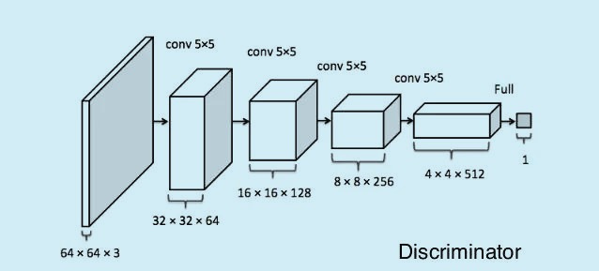
Deeper Look at Discriminator
The final layer uses a sigmoid activation function to ensure that the output scalar value is in the range [0, 1], which can be interpreted as the probability that the input image is real.

Slide 9
Model Training
During training, the model is optimized using the Adam optimizer with a learning rate of 2e-4 and a batch size of 64. The model is trained for [5,10,15] epochs on a dataset of images that are preprocessed using a set of transformations that include resizing, normalization, and conversion to a tensor.

Slide 10
Model Training
The loss function used to train the model is the binary cross-entropy loss, which measures the difference between the predicted output of the discriminator and the true label (1 for real images, 0 for fake images).

Slide 11
Implementing the Model
The model is implemented using PyTorch and includes a function to initialize the weights of the neural networks using a normal distribution with mean 0 and standard deviation 0.02.
The training loop logs the losses and generates example images using the SummaryWriter class from PyTorch's torch.utils.tensorboard module.
The example images are generated by passing a fixed noise vector through the generator network and visualizing the output images.
The SummaryWriter class allows the user to visualize the training progress and monitor the performance of the model over time.

